Slide 1
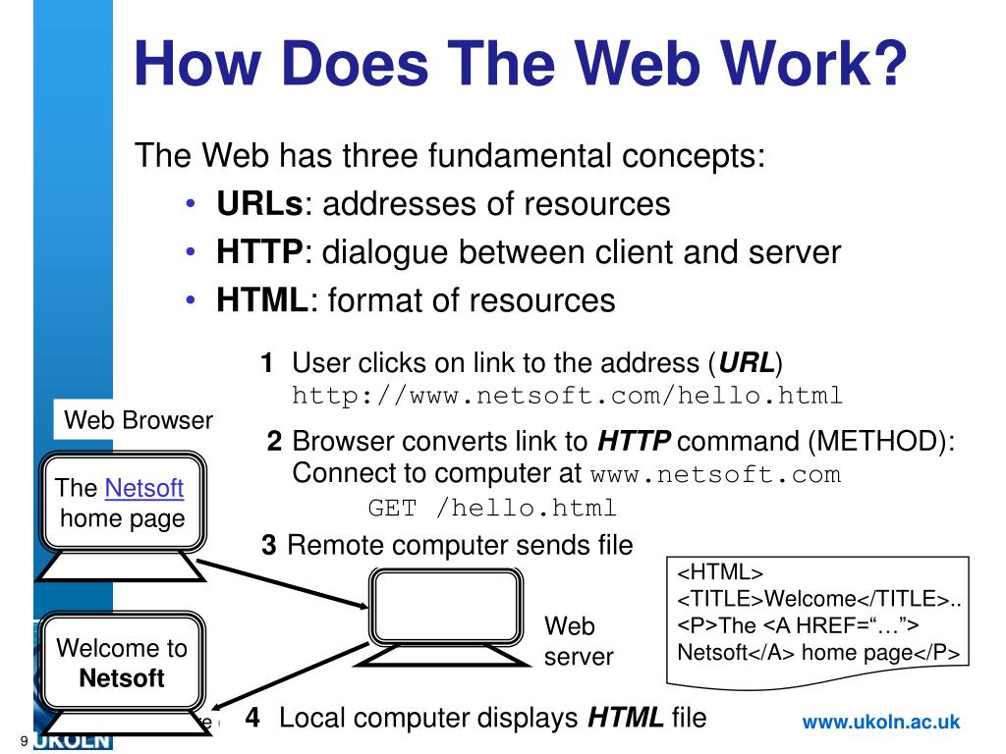
How does the web work?
.The browser send an HTTP message to the sever
Asking for a copy of the website to the client ;and all the others data sent between the client and the server ;wit your internet connection using ip…

Slide 2

What do you need to be a web developer?
.To be a web developer you must have your complete education to devlope your programming skills and your basic coding ;
Also you must be patient and have an incredible imagination and thinking out the box to resourd problems ext and being professional in your job ……

Slide 3
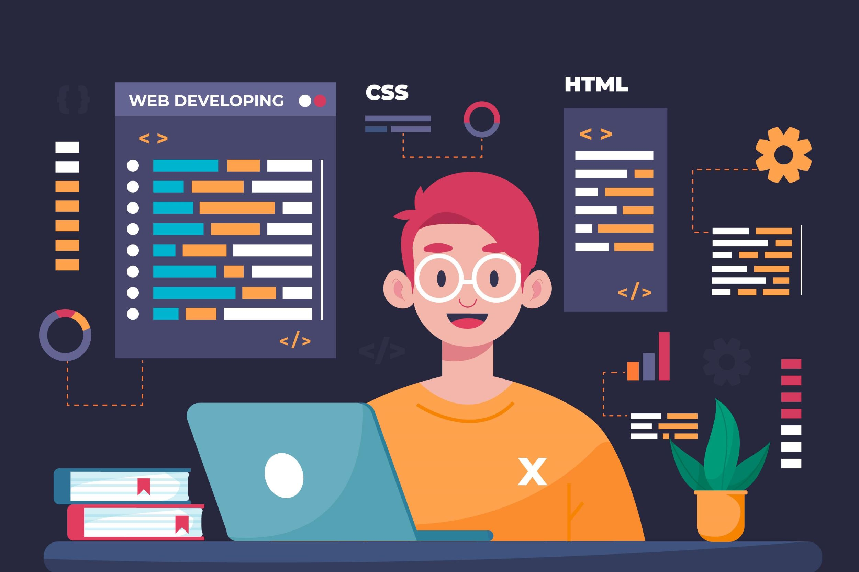
Why did you choose to learn web development?
I choose to learn web devlopment for many things first this domain is the futur you can have a job easily without problems .
Second for high pay jobs which every society in every country need web devlopers …
Third and finally this job learn you many skills and devlope your curently skills also you will be more social with others ……

